Slide 1
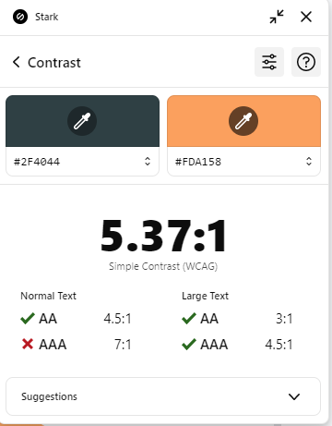
OSC
Science & tech Dot Net Entity Framework Core
Poula saber & Tasneem

Slide 2
Table of contents
01
02
03
04
05
06
Introduction to ORM
DbContext
Migrations
conventions
07
08
Configuration: Columns & Mapping
Fluent API
Execute Delete and Update
Data Loading Strategies

Slide 3
01
Introduction to ORM
Object-Relational Mapping

Slide 4



EF Core ?
Entity Framework is a ORM (Object Relational Mapper)
ORM
Objects
Database

Slide 5
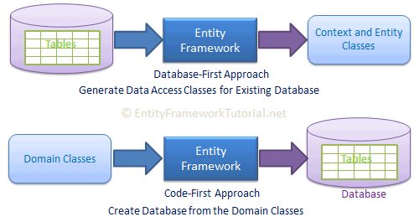
EF Core Approaches: Code First vs Database First

Slide 6
provider
SQL Server SQLite PostgreSQL MySQL MariaDB Oracle Azure SQL Database Google cloud SQL

Slide 7
Code-First Workflow
1- write Classes (Models) in C#
2- Extend DbContext
3-Configure the Connection String
4- Add Migration
5-Update Database
6- Use LINQ to manipulate the data

Slide 8
NuGet Packages
1- Microsft.EntityFrameworkCore
2- Microsft.EntityFrameworkCore.Tools
3- Microsft.EntityFrameworkCore.SqlServer

Slide 9
02
DbContext

Slide 10
DbContext
DbContext is the main class in Entity Framework that acts like a bridge between your C# code and the database.
context class that derives the DbContext
turn domain classes into entities by specifying them as DbSet<Tentity>
Configure Database Connection

Slide 11
03
Migrations

Slide 12

Migrations
EF Core migrations are a set of commands which you can execute in Package Manager Console or PowerShell or in .NET Core CLI (Command Line Interface).

Slide 13
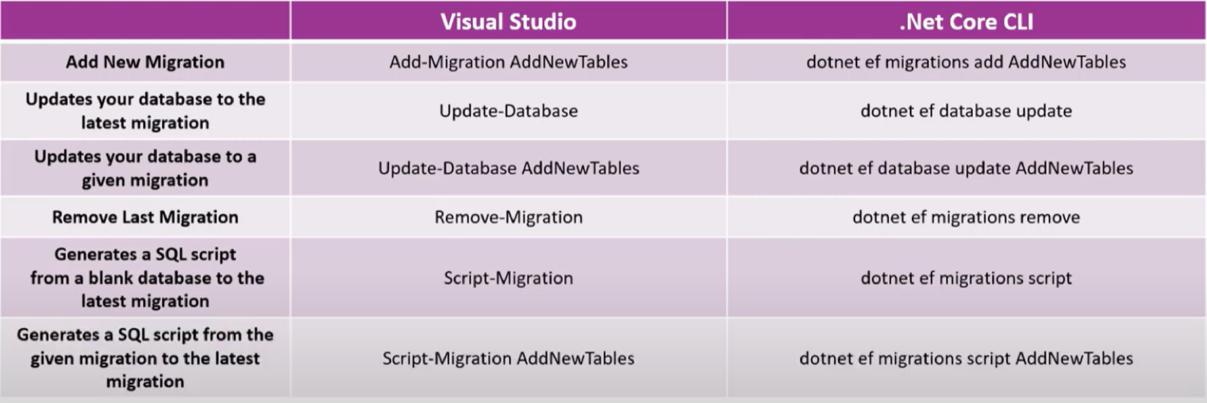
Most important EF Core migration commands

Slide 14
Hands on #1 (5 minutes)
Create a class that derives from DbContext.
Convert your plain C# classes into EF Core entities. (grade, student)
Use EF Core migrations to create the initial database.
Add a new attribute Gender to the Student class and update the database.
Return to the initial migration state.

Slide 15
04
Conventions

Slide 16
Conventions
EF Core will create database tables for all DbSet<TEntity> properties in a context class with the same name as the property. It will also create tables for entities which are not included as DbSet properties but are reachable through reference properties in other DbSet entities.

Slide 17
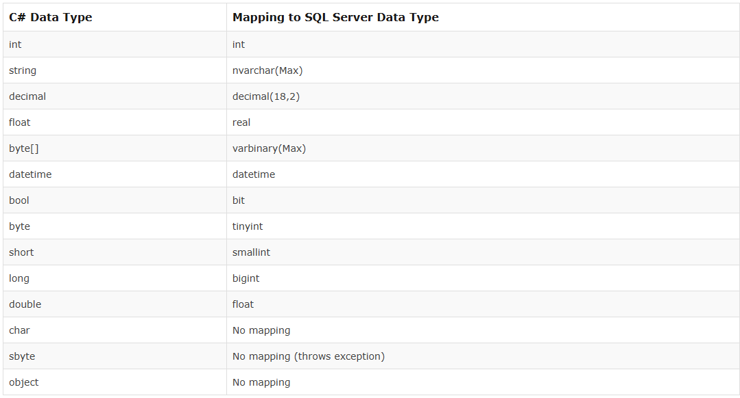
Column Data Type (SQL Server)

Slide 18
Nullable Column
EF Core creates null columns for all reference data type and nullable primitive type properties e.g. string, Nullable<int>, decimal?.
NotNull Column
EF Core creates NotNull columns in the database for all primary key properties, and primitive type properties e.g. int, float, decimal, DateTime etc..
Primary Key
EF Core will create the primary key column for the property named Id or <Entity Class Name>Id (case insensitive).
Foreign Key
As per the foreign key convention, EF Core API will create a foreign key column for each reference navigation property in an entity with one of the following naming patterns.

Slide 19
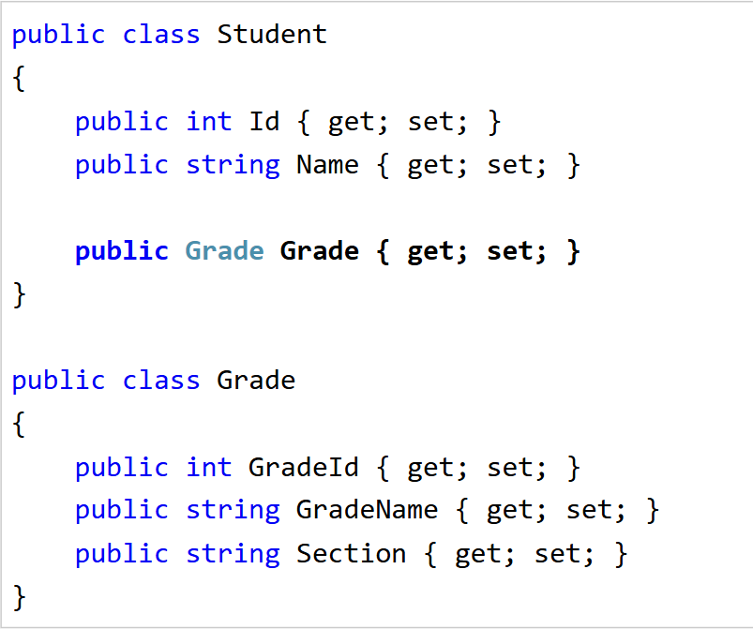
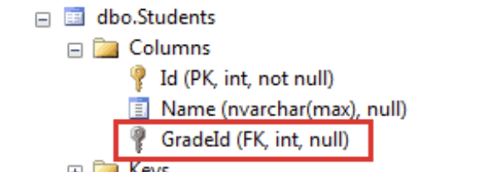
One-to-many relationship conventions
Convention 1 :
We want to establish a one-to-many relationship where many students are associated with one grade. This can be achieved by including a reference navigation property in the dependent entity as shown below.
Notes:
(here, the Student entity is the dependent entity and the Grade entity is the principal entity)

Slide 20
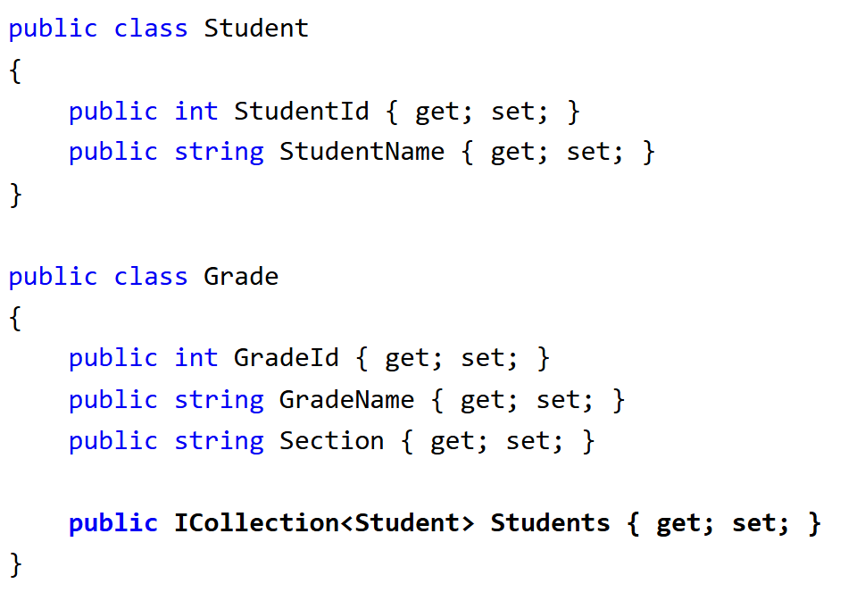
One-to-many relationship conventions
Convention 2 :
Another convention is to include a collection navigation property in the principal entity as shown below.
Notes:
In the example above, the Grade entity includes a collection navigation property of type ICollection<student>. This will allow us to add multiple Student entities to a Grade entity, which results in a one-to-many relationship between the Students and Grades tables in the database, just like in convention 1.

Slide 21
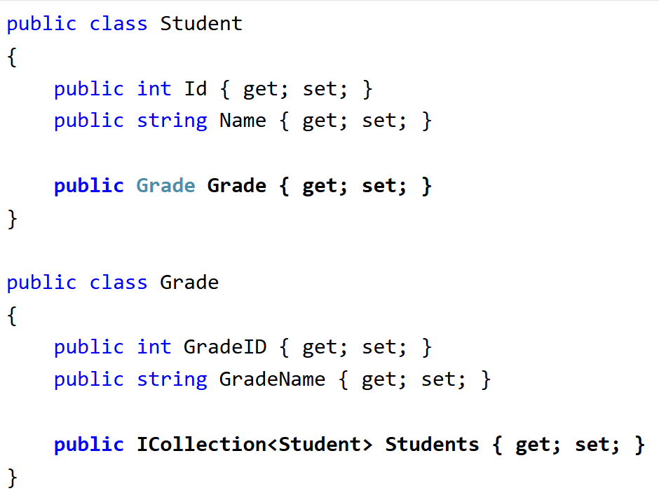
One-to-many relationship conventions
Convention 3 :
Another EF convention for the one-to-many relationship is to include navigation property at both ends, which will also result in a one-to-many relationship (convention 1 + convention 2).
Notes:
In the example above, the Student entity includes a reference navigation property of Grade type and the Grade entity class includes a collection navigation property ICollection<Student>, which results in a one-to-many relationship between corresponding database tables Students and Grades, same as in convention 1.

Slide 22
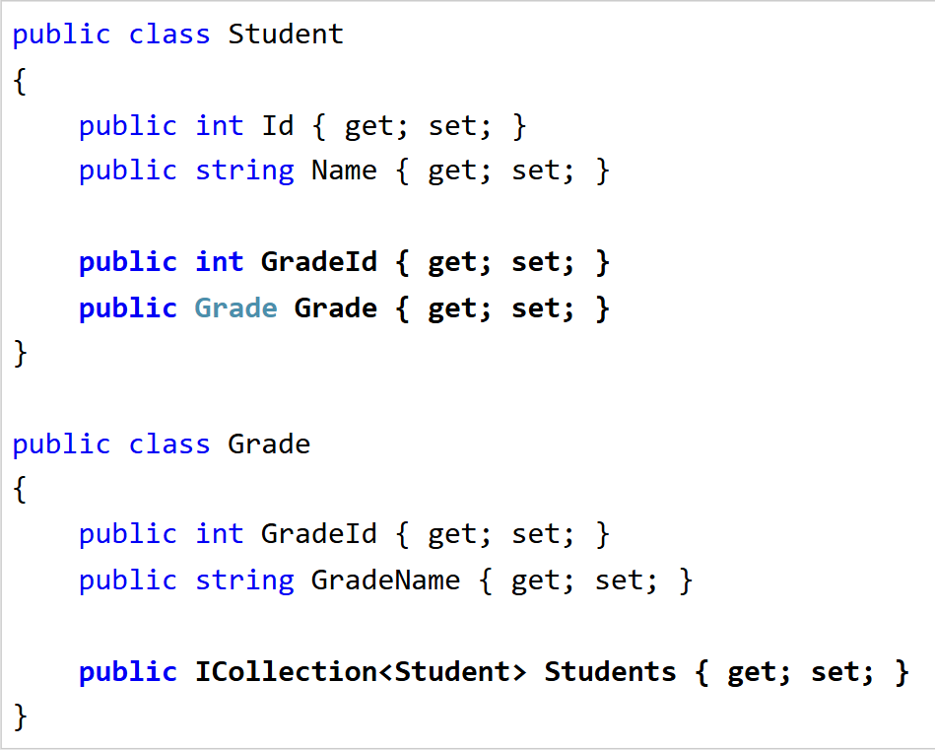

One-to-many relationship conventions
Convention 4:
Defining the relationship fully at both ends with the foreign key property in the dependent entity creates a one-to-many relationships.
Notes:
In the above example, the Student entity includes a foreign key property GradeId of type int and its reference navigation property Grade. At the other end, the Grade entity also includes a collection navigation property ICollection<Student>. This will create a one-to-many relationship with the non null foreign key column in the Students table, as shown below.

Slide 23
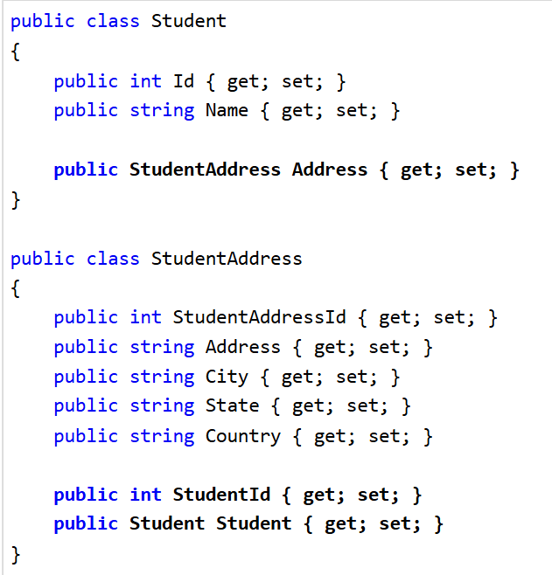
One-to-One Relationship Conventions
In EF Core, a one-to-one relationship requires a reference navigation property at both sides. The following Student and StudentAddress entities follow the convention for the one-to-one relationship.

Slide 24
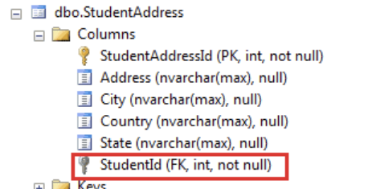
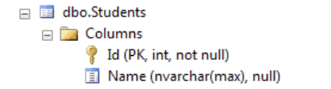
One-to-One Relationship Conventions

Slide 25
05
Configurations

Slide 26
Configurations in Entity Framework Core
You learned about default Conventions in EF Core in the previous chapter. Many times we want to customize the entity to table mapping and do not want to follow default conventions. EF Core allows us to configure domain classes in order to customize the EF model to database mappings. This programming pattern is referred to as Convention over Configuration
Data Annotation Attributes
Fluent API

Slide 27
Data Annotation Attributes
In Entity Framework (EF) Core, data annotations are attributes applied to entity classes and their properties to configure the data model and override EF Core's default conventions.

Slide 28
Fluent API Validations
In the context of ASP.NET Core, developers often use the term “Fluent API validations” to describe the implementation of validation rules using the FluentValidation library. This external library provides a way to define validation rules using the Fluent Interface Design Pattern or you can say using the concept called Method Chaining where we can invoke multiple Fluent API Validator methods one after another using the dot (.) operator.

Slide 29
Fluent API Validations
Fluent Interface: As the name suggests, FluentValidation employs a fluent interface, allowing you to chain methods together for more readable validation rules.
Separation of Concerns: With FluentValidation, validation rules are typically defined in separate validator classes instead of being decorated directly on model properties. This leads to a cleaner separation between model definition and validation logic.
Powerful and Expressive: It allows for more complex validation scenarios, including conditional validation, collection validation, and cross-property validation.
Integration with ASP.NET Core: FluentValidation offers seamless integration with ASP.NET Core’s model binding, so if a model fails validation, the ModelState will be marked as invalid, much like it would be with Data Annotations.
Custom Validators: You can create custom validation rules if the built-in ones don’t cover your needs.

Slide 30
Aspect | Data Annotations | FluentValidation (Fluent API)
Expressiveness | Limited expressiveness; not ideal for complex rules | Highly expressive; great for complex and conditional validation
Extensibility | Custom validation requires creating custom attribute classes | Easily supports custom rules via simple lambda expressions
Integration | Built-in with ASP.NET Core model binding | Requires setup, but official FluentValidation packages make integration simple
Performance | Slightly faster for simple validations (no external overhead) | Slight overhead due to dynamic execution; usually negligible in real-world use
Dependency | No external libraries needed; part of .NET | Requires the FluentValidation NuGet package
Maintenance & Readability | Can clutter model classes with many attributes; harder to manage complex logic | Centralizes validation logic; improves readability and maintainability

Slide 31
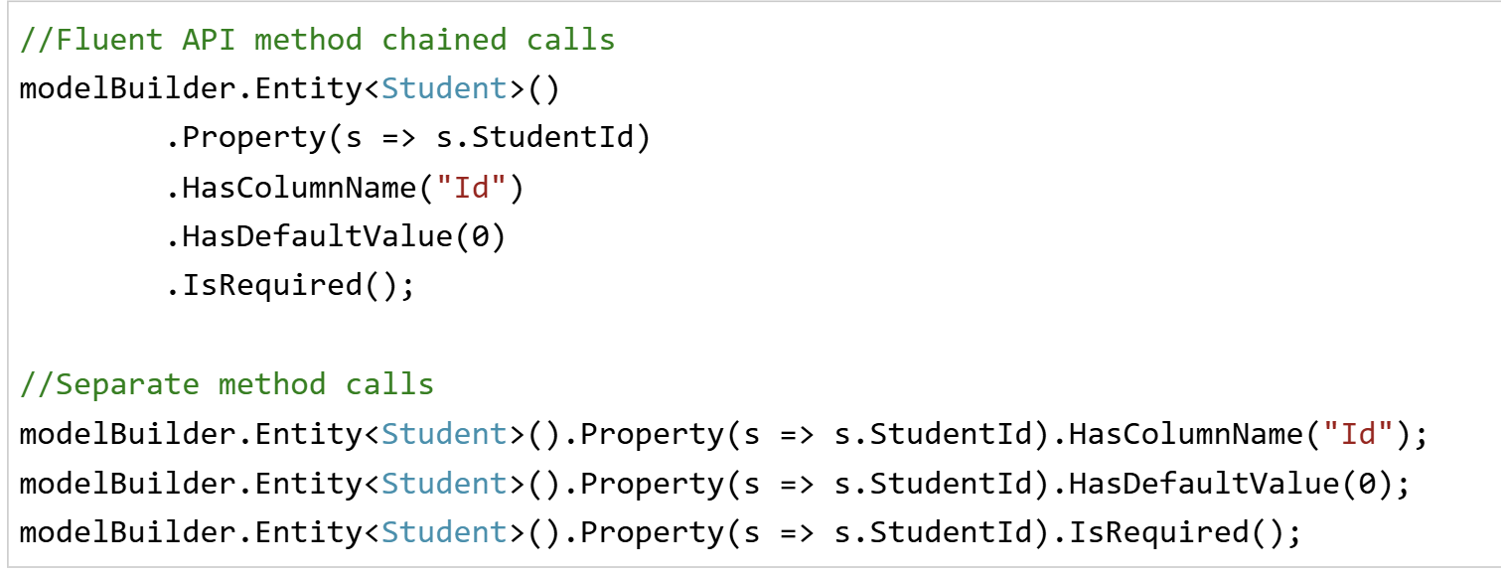
Chaining ?

Slide 32
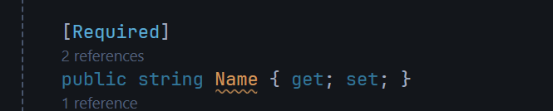
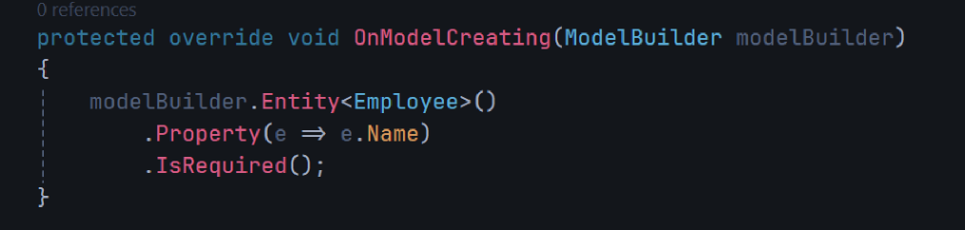
Create property
Data Annotations
Fluent API

Slide 33
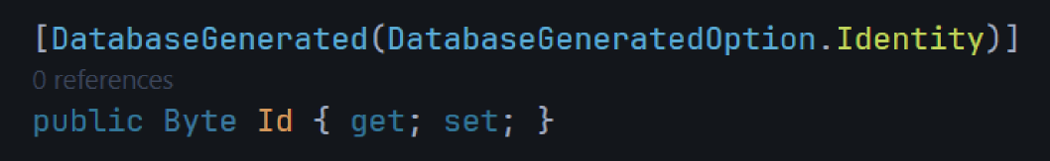
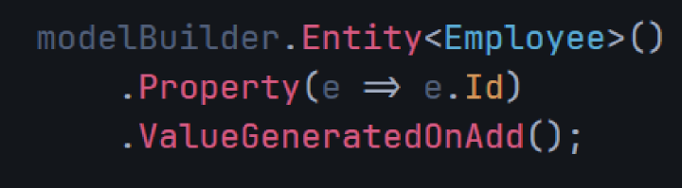
Set Identity for Keys with data type that is not int, long (set auto-generated value)
Data Annotations
Fluent API

Slide 34
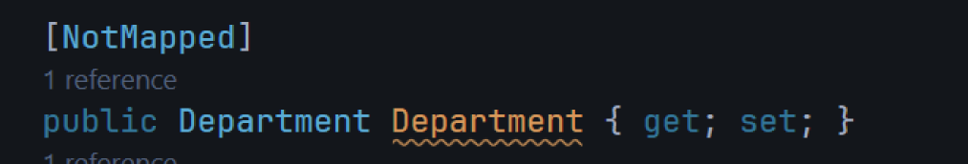


Exclude Entity From Model
Data Annotations
Fluent API

Slide 35
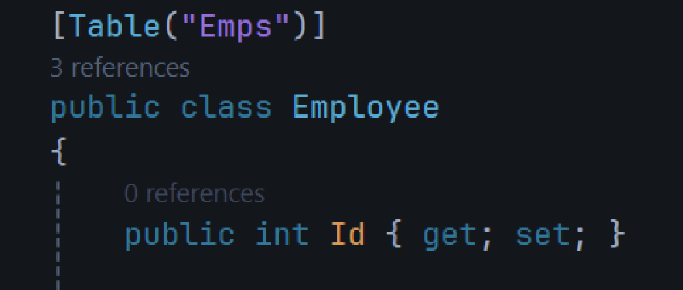
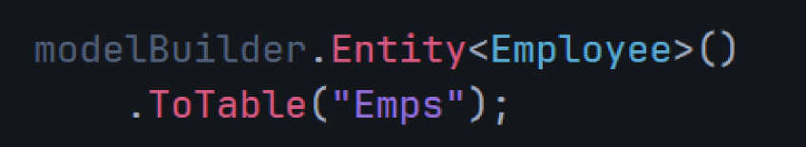
Change Table Name
Data Annotations
Fluent API

Slide 36
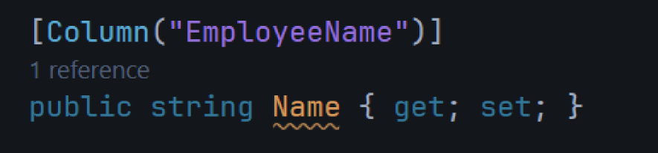
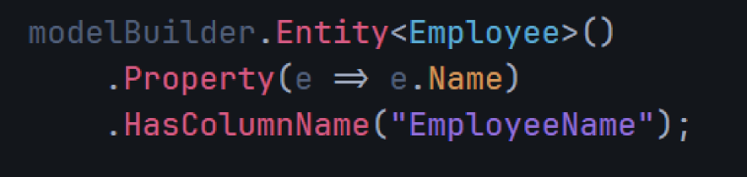
Change Column Name
Data Annotations
Fluent API

Slide 37
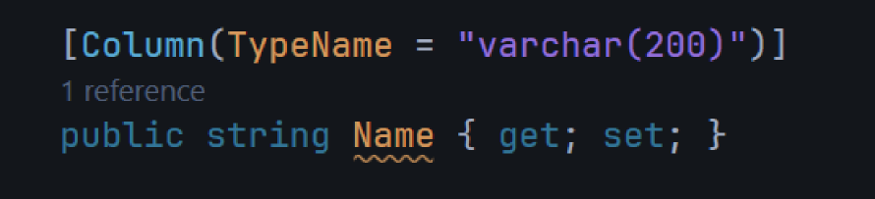
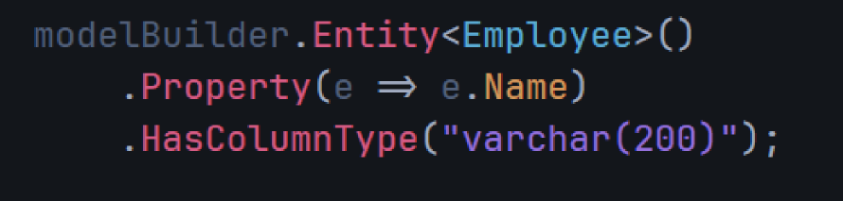
Change Column Data Type
Data Annotations
Fluent API

Slide 38
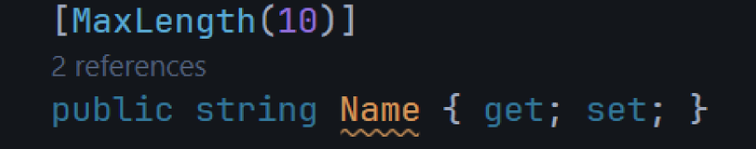
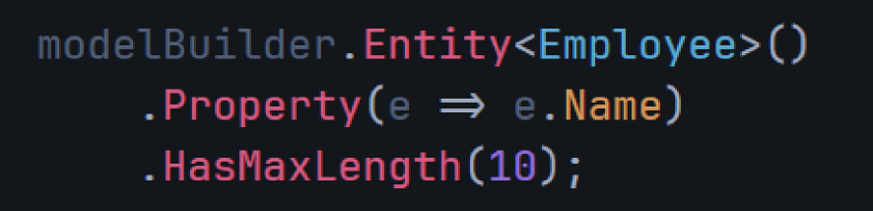
Set Property Max Length
Data Annotations
Fluent API

Slide 39
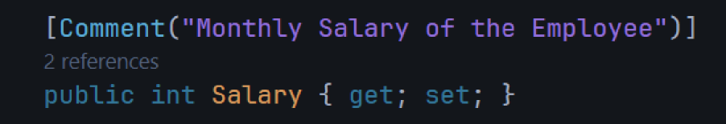
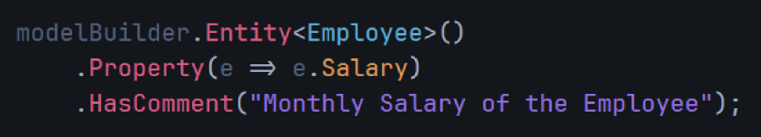
Set Column Comment
Data Annotations
Fluent API

Slide 40
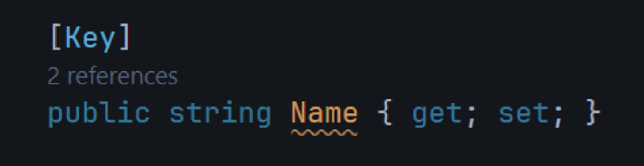
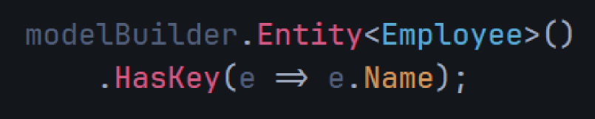
Change Primary Key
Data Annotations
Fluent API

Slide 41
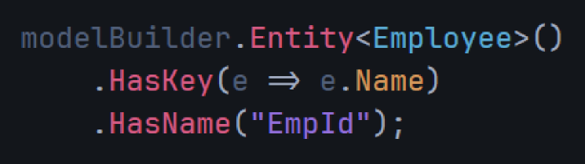
Change Primary Key Name
Cannot be done with Data Annotations
Fluent API

Slide 42
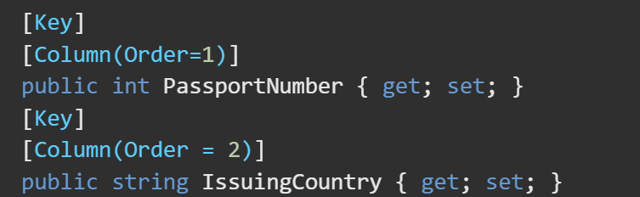
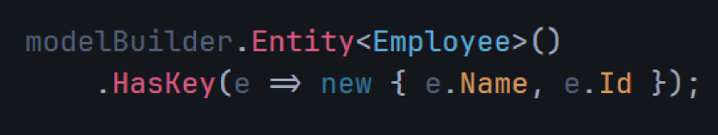
Composite Key
A composite key is a primary key made up of two or more columns that together uniquely identify a row in a table.
Data Annotations
Fluent API

Slide 43
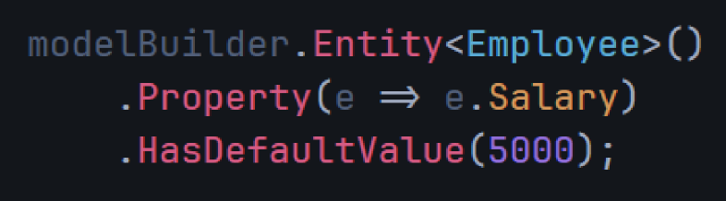
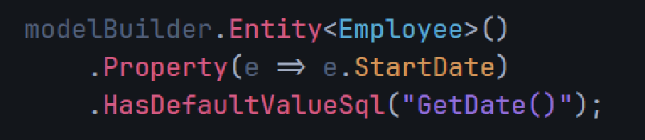
Set Default Value
Cannot be done with Data Annotations
Fluent API

Slide 44

Exclude property (MiddleName) — even if it's not in the class, just for demo
Set default value (IsActive = true)
Set identity/autogenerated key on non-int (StudentCode as Guid)
Change table name to tbl_Students
Change column name FirstName → student_first_name
Change column type of Height → decimal(5,2)
Set max length for LastName → 50
Add comment on Weight
Change PK from StudentId → StudentCode (composite key kept optional)
Change PK name to PK_Student_Code

Slide 45
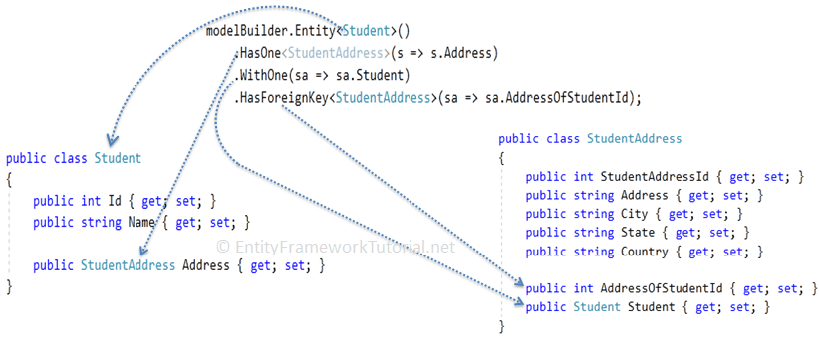
Relations
1- One to many relationship

Slide 46
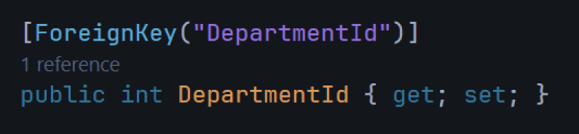
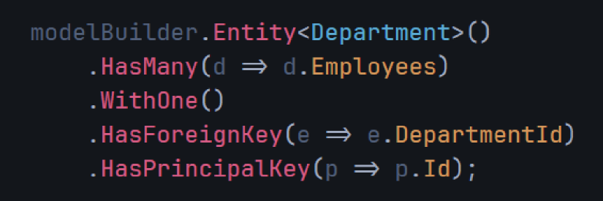
Relations
1- One to many relationship
Data Annotations
Fluent API

Slide 47
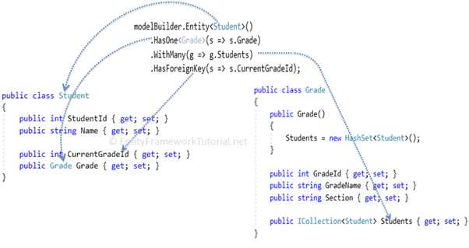
Relations
2- One to many relationship

Slide 48
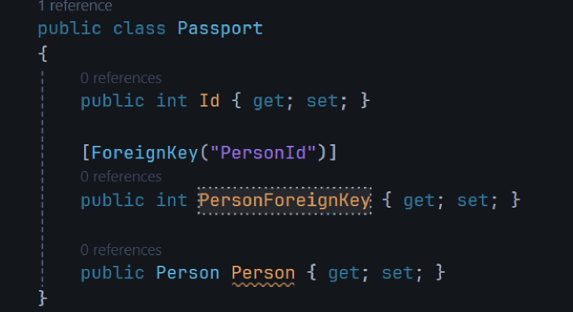
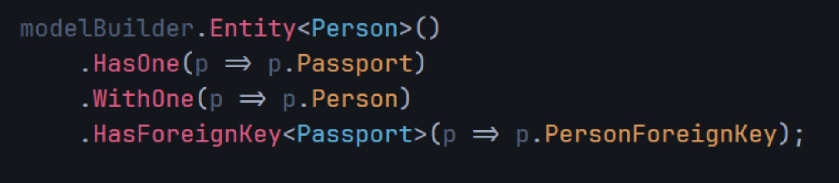
Relations
2- One to many relationship
Data Annotations
Fluent API

Slide 49

Relations
3- Many to many relationship
The many-to-many relationship in the database is represented by a joining table which includes the foreign keys of both tables. Also, these foreign keys are composite primary keys.

Slide 50
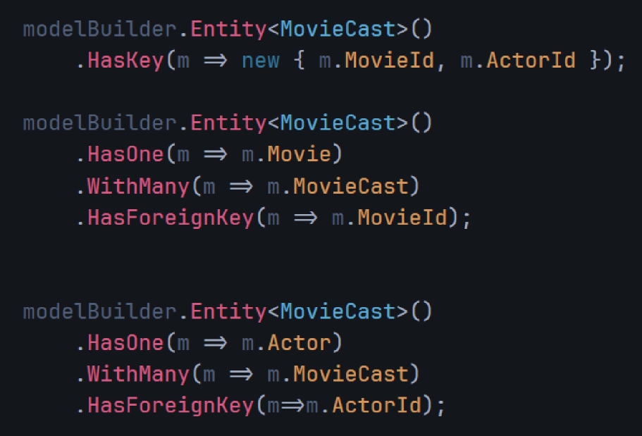
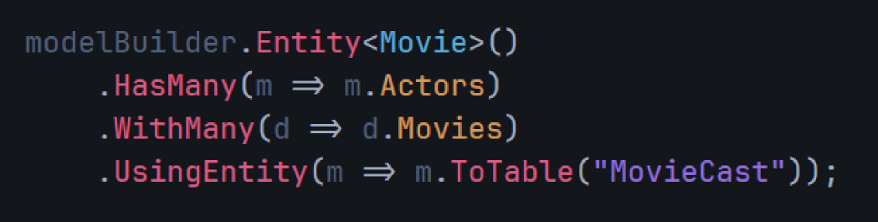
Relations
3- Many to many relationship
Fluent API

Slide 51
Feature | Requirement
Navigation type | One Grade has many Students
Foreign key | Student.GradeId is the foreign key
OnDelete behavior | Delete students when grade is deleted

Slide 52
break!

Slide 53
07
CRUD operations

Slide 54
CRUD Operations:
create
Update
C
U
R
D
Read
Delete

Slide 55
reschedule all appointments of Doctor Id =1 to one Day Later
2. Add a doctor and Appointment using Navigation Properties for 2 Existed patients (id =1, id =2),
Hints:
Create Doctor Object
Retrieve patient from DB
Add Appointments to the created Doctor
Finally Add the doctor to DB
Save

Slide 56
08
Data Loading Techniques

Slide 57
Why Loading Techniques??
NullReferenceException??

Slide 58
Loading techniques
1- Exciplict Loading
2-Eager Loading
3- Lazy loading
load after the main query
load with the main query
load only when accessed

Slide 59
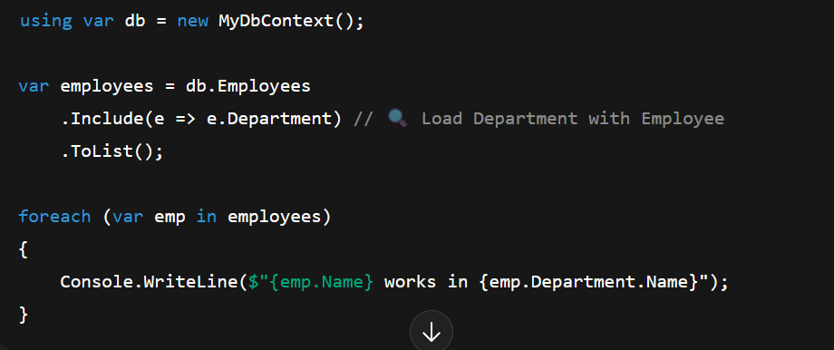
1-Eager Loading => Include()

Slide 60
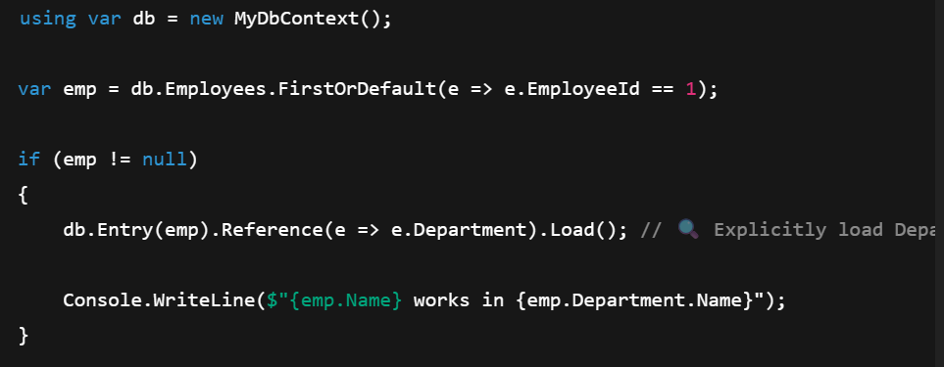
2-Explicit Loading => Load()

Slide 61
3-To obtain Lazy Loading => (implicitly)
A-Download Package =>Microsoft.EntityFrameworkCore.Proxies
B- Add .UseLazyLoadingProxies() After the ConnStr
C- Convert All Navigational Properties to Virtual

Slide 62
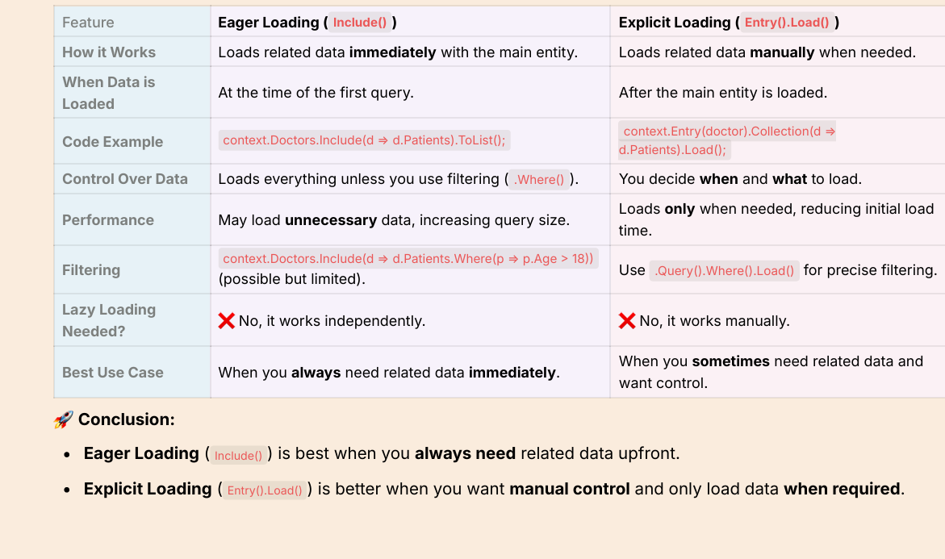
Eager loading vs Exciplicit loading

Slide 63
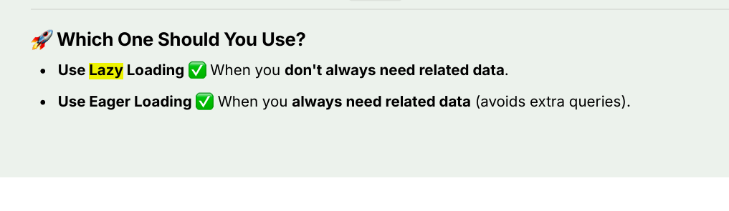
Which one to use?

Slide 64
Thanks!

